Slide 1
MIND OVER MATTER
Katie Dowds, Aisling Mullen & Síne Ryan

Slide 2
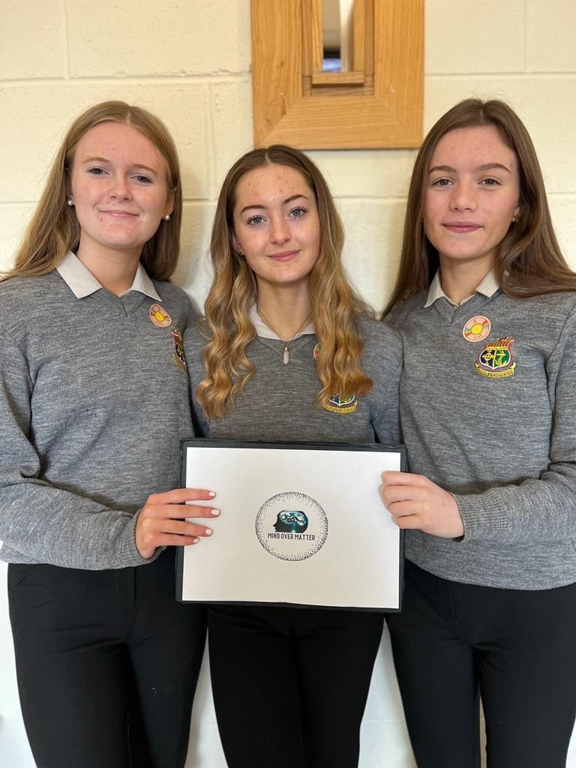
WHO WE ARE:
The power of the mind & the need to build resilience to deal with the ups & downs that come with sport.
2
Notes:
We are a group of Transition year students who have noticed & experienced a big problem in the sporting industry.

Slide 3
OUR ROLES
Katie Dowds
Aisling Mullen
Síne Ryan

Slide 4
BUSINESS CONCEPT-OUR IDEA
To create an “Awareness Resource Pack” for all sports clubs to help strengthen their players’ mindset so as to maximise their performance in their chosen sport.

Slide 5
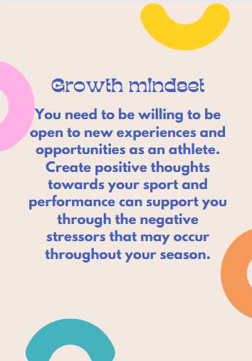
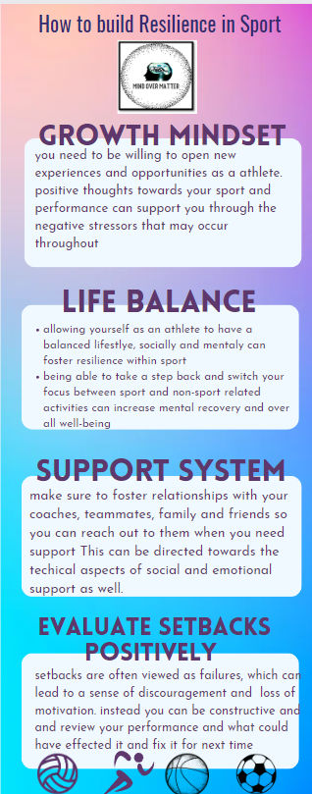
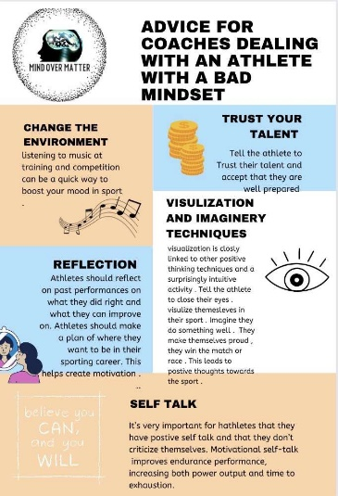
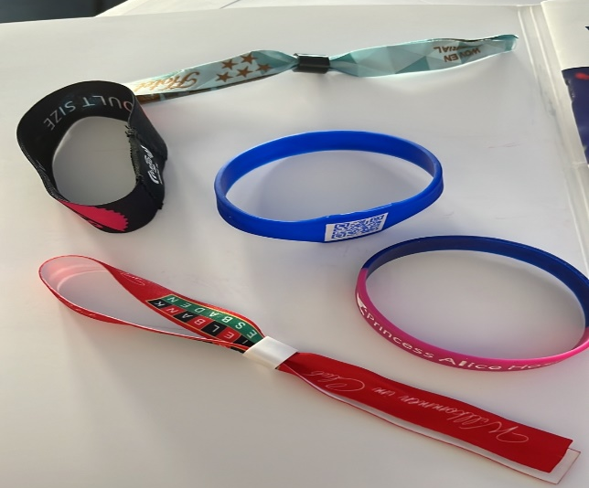
MIND OVER MATTER PRODUCT
Resource Pack
Five strategic cards aimed at dealing with losing, not making the cut or injury.
An infographic advice card for Coaches.
Mind Over Matter Bracelets.

Slide 6
OUR TARGET MARKET
Sports Clubs and Organisations
GAA​
Soccer
Boxing
Athletics
Basketball​

Slide 7
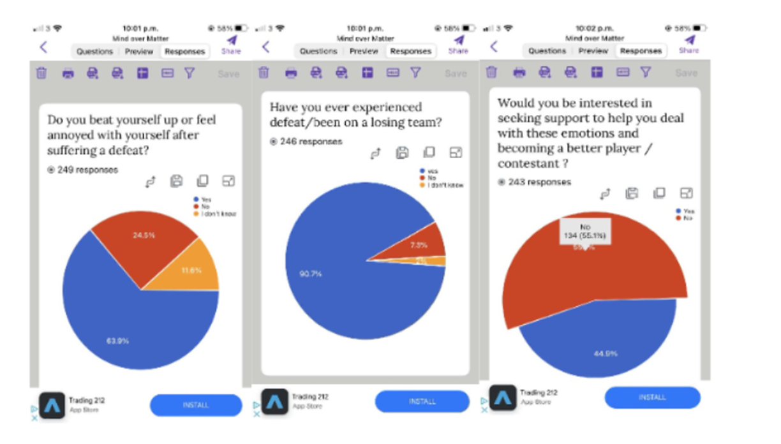
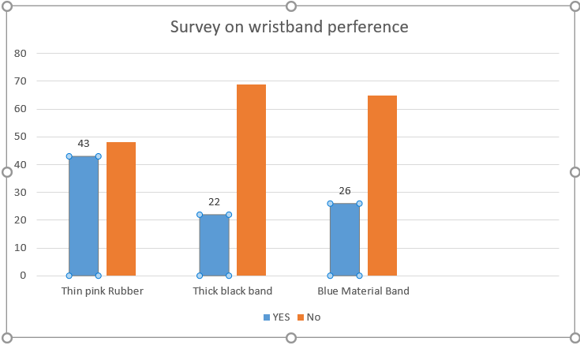
Market Research

Slide 8
Focus Group
To provide feedback from players and their experiences.
Shaun Patton - Donegal GAA goalkeeper ex-league of Ireland
Karen Guthrie - Donegal LGFA player
Nicola Lacey - Head of Tourism and sport in ATU, Former
Donegal LGFA player
Keith Cowan & Michael Harris –Finn Harps FC
The pack was also sent out to the following athletes/coaches for their review:
Jim Mc Guinness (MCs in Sports Psychology)
Jason Quigley (Boxing)
Nakita Burke (Athletics)
Myles Sweeney (Donegal Sports Partnership)

Slide 9
Feedback:
‘Powerful tool- wish we had this resource when we were younger’
‘This should be as important as teaching the fundamental movements’
‘Consider providing the wristband in club colours with space for their own club inspiring word’
Eg Believe, Focus, Drive….’
‘Great visual to be displayed around clubs/schools to create awareness to this very important minefield of Sports Psychology’
‘Definitely develop your online plan as athletes need access to these strategies anytime/anywhere.’

Slide 10
FINANCE
DONEGAL SPORTS PARTNERSHIP
We applied for investment from our local Donegal sports partnership & they informed us that we were successful.
We aimed at funding for 50 packs & wristbands but they have advised us to resubmit for 100 packs.
We are also in negotiation about having a platform on their website.
10

Slide 11
WHATS NEXT:
Online resource-Individual/Team.
Scat Confidence test/Sports Psychological Questionnaire
Inspirational Quotes
Team Rooms- Diary Log. Boardroom, Worksheets, Padlet-What went well
SOCIAL MEDIA:
Project Ambassadors
Facebook/instagram/Twitter

Slide 12
SUMMARY
We're excited about our product and business and hope it is of benefit to many athletes for years to come.
We wish them all the best of luck and hope they have fun participating in their sport.

Slide 13
THANK YOU
‘A true sign of a teams character is not defined by a win or a loss. It is defined in the response to those results’
Sean Nahas

