Slide 1
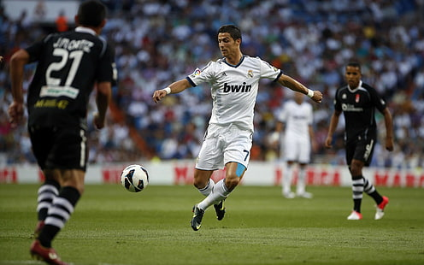
PE Expo 2021
How to improve performance in the last 10 minutes of Competition.

Slide 2
Introduction to the project
In this project, I plan to study and to have a better understanding of how my performance could improve in the latter stage of a match, and how to implement this new knowledge into my personal preparation for my sport.
I choose this topic from personal experience. In May 2020, I was playing in an important League of Ireland Underage Match where a high standard of football was required. My team had played a good first half, but as the game progressed in to the second half, we conceded 3 late goals.
I believe this loss was as a result of not being mentally and physically prepared to make the best decisions in the last 10 minutes of the game. This insufficient preparation contributed to our defeat. I believe by undertaking this project, I will have a better understanding of my own preparation while in my TY year, as well as getting an important introduction into the science of Physical Education. I have chosen PE for my Leaving Cert, and this introduction has excited my interest for next year's study.

Slide 3
POA
I undertook several steps in order to find the most interesting and appealing topics to examine and how to apply these topics to my sporting life.
I started by brainstorming ideas on a blank sheet until I came across my chosen topics.
I then contacted 2 Physical Education teachers in my school for their input on my chosen topic and asked their advice on how I could carry out this project.
I planned my project focusing on what areas of interest to research; whom to contact; how to survey experienced athletes; what questions to ask these athletes; and what areas of information to focus my research on that would be relevant to my project.

Slide 4
POA
I broke my heading into 3 different topics.
Psychological. I examined how Psychological Preparation in a contest lasting that lasts 90 minutes or more is managed , and how elite teams and athletes across Europe improve their mental approach to a sports event.
Physical; Physical Preparation needs to be at the highest standard, but does it come down to just how far physical energy alone will make you go, or are there other factors?
Nutritional; Can certain foods enable more energy and performance for longer time in the highest standards of sport.

Slide 5
Psychological Training
'Psychological resilience is important in sport because athletes must utilize and optimize a range of mental qualities to withstand the pressures that they experience'.
In my personal experience, as I get older and more focused on my pre-match preparation, I find my phycological preparation plays a major role in how I play, and how I feel going into a game. I researched how World Champions, successful athletes and teams overcame phycological challenges and how they manage their challenges while improving their playing ability. In Elite sport, margins between success and failure are minimal – the difference is down to whether the athlete is psychologically prepared for competition.

Slide 6
Psychological Factors
There are two main psychological factors that are important if an athlete is resiliently prepared. These are-
1. "Challenge appraisal" ; seeing a match as an opportunity to win instead of one for failure which is "Threat Appraisal" . Developing resilience by athletes through previous exposure and adaptation through experience assists athlete's management of match day challenges.
2. Meta-Cognitions. is described as an individual’s awareness and control over their own thought process. For example, using techniques such as self-talk and imagery in order to gain control over their performance .

Slide 7
Psychological Study
Martin-Krumm found that athletes with a developed optimistic explanatory style learn from sporting failures, as opposed to an athlete with a more pessimistic style. Many high-performance athletes claim that 90% of their success comes from mental training and psychological preparation.

Slide 8
Psychological Resilience
As an example, Leicester City FC had lost the Championship playoff semi-final in 2012/2013 season. Leicester then viewed the next season as a challenge instead of a threat. The team was more emotionally experienced and brought this experience into their approach. This relates to Turner & Baker’s (2013) notion that challenge appraisal is developed through previous experiences of adversity. This approach was the foundation of Leicester City's subsequent success.

Slide 9
Psychological
This Banduras Model shown here suggests that an athlete's performance with task specific confidence is dependent on these four factors shown here.
To illustrate this, Yoggi Berra , the charismatic baseball coach, once famously said that "90% of the game is half mental."

Slide 10
Psychological
Dr. David Fletcher & Dr Mustafa Sarkar suggest in order to improve resilience in athletes, the psychological factors in the graph opposite show that "influence resiliency" should be identified and closely monitored, in conjunction with the athlete’s environment. Therefore, appropriate early psychological intervention should be used in order to reach the optimal level and balance of these factors in the athlete's preparation.

Slide 11
Psychological Conclusions
In this project, I learned an approach for each match to face challenges in a positive mind set, and how to react to setbacks. A better understanding of the need for confidence in my own ability and how my emotion can affect my performance, especially in the last 10 minutes. I need to look on opportunities and challenges with a positive approach. There is no benefit in anxiety before an event. Learn to enjoy the challenge and gain from the experience.

Slide 12
Psychological Conclusions
This topic was most interesting and beneficial in gaining an insight into improving my sporting mentality and approach to the last 10 minutes of competition. My survey and conversations with various elite athletes and managers surprised me in how useful this aspect of this project was to my understanding of this topic.
A conversation I had with an All-Ireland Winning County Manager was one of the most beneficial events. His advice regarding the need for repetition of skill and accuracy training was invaluable. This natural learned repeated process can be the difference in winning and losing of the last 10 minutes. It leads to reliable performance when end-of-match pressure is high and fatigue an issue. The repeated training of essential skills allows confidence in ability to provide these skill without fear of failure late in competition. This limits any doubt in the mind to instinctive actions and responses.

Slide 13
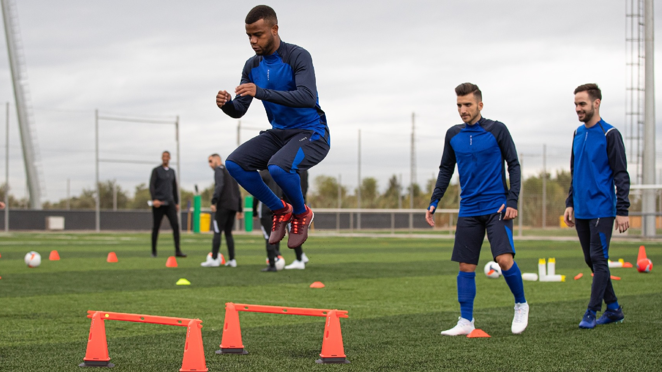
Physical Preparation for Last 10 minutes of Competition.
Top soccer players do not necessarily have to have an extraordinary capacity in any of the areas of physical performance. Soccer training is largely based on preparation for games. Soccer Physical Training methods in general uses Endurance Interval Training at an intensity at 90-95% of maximal heart rate in 3-to-8-minute bouts. This has proved to be effective in the development of endurance, skills training and performance improvements. Footballers cover an average of 10km per game, but because of my wish to be better than an average footballer, I now wish to ensure my body can function better than average in the conclusion of matches.

Slide 14
My Physical Approach
Must Include the Following
I must use exercises and drills that are going to help increase my stamina and give a competitive advantage over my competition.
My key training takeaways must be mimic the demands of my sport wherever possible.
To Mix my training between different energy systems
To not "Take it easy". Make sure I'm not just going through the motions in my training session. In short, Push myself.

Slide 15
My Physical Approach;
When most footballers think about increasing their stamina, the usual approach will be “ I’ll just go for a long run”.
Experts now say this is not the best thing to do.
Research has shown that over the course of one-minute footballers will change their movement pattern 11 times.
It’s very rare in a football match that a player jogs at a consistent pace for long periods. Most games will involve changing pace regularly, going from walking to sprinting to jogging to stopping.

Slide 16
Physical Training for Football.
The research shows for competitive match, footballers will walk for 25%, jogging 37%, running at submaximal effort 20%, maximum effort sprinting for 11%, and 7% of the time moving backwards. Most footballers will cover 10 km in a match, but not at one steady pace.
For sporting activity, the body uses the ATP-PC system. For high intensity short activity, the anaerobic system is used and for prolonged low intensity activity, the aerobic system. During long, steady runs, the body only uses the aerobic system. It’s not ideal to focus solely on long stamina runs to prepare for football matches, where anaerobic activity is dominent.

Slide 17
Physical Training Conclusion
The physical fitness of a footballer is taken for granted, and footballers are expected to be fit. 'Fit enough to play a match' is a term that varies for every footballer. I used to think the best thing to get fitter would be to go out and run 10k's.
In doing this study I discovered that this technique is not beneficial to me. Focusing on interval training and using the anaerobic system is more valuable for a player in my position of centre mid. I now compare my stats against the professional elite footballers. On average, Real Madrid player Toni Kross runs just under 10k a game. Last year, I ran around 11-12 K per game which is close to his figure, I will focus on using more energy when 'on' the ball instead of 'off' the ball.

Slide 18
Nutritional
Nutrition plays a valuable role in optimizing performance of elite players during training and matches, while maintaining overall health throughout the season.
An evidence-based approach to nutrition should emphasize that a ‘food first’ philosophy of food over supplements which is fundamental to ensure effective player nutrition and fuel. The science underpinning sports nutrition is evolving fast, and coaches and nutritional advisers must be alert to new developments in this developing and exciting field in sports performance.

Slide 19
Nutritional Preparation for a High-Performance Athlete.
With much information available, I decided to focus on a reputable source of information. The FC Barcelona Website have a well-regarded, detailed and safe reference guide that suited my research needs. Although detailed and complex, every Elite and Team Footballer must have a Dietary strategy.
Any nutritional/ fluid plan must be personal to the athlete at that time A plan must vary to the needs of the athlete; the activity plan; the fitness of the athlete; the time of year;
This is essential for endurance in the last 10 minutes of Competitive games. The FC Barcelona breaks down dietary requirements to Nutrition and Fluid Balance.
No one plan fits all !

Slide 20
Nutrition-Performance on Match Days
Joshua Dyson is a nutrition consultant at the Manchester Institute of Health and Performance. His advice includes "The goal of the pre-match meal is to top up carbohydrate energy stores. Around 2-3 hours prior to kick off, consume a meal rich in carbohydrate with moderate protein. To minimise the risk of gastro-intestinal issues (e.g., bloating, stomach cramps), the best pre match meals would be 'Pasta with tomato sauce and some chicken' or 'a curry with cous cous'."

Slide 21
Nutrition-Performance on Match Days
How to recover after a game - Joshua Dyson says to focus on the 3 R's.
Repair-"Look to consume around 20-30g of high-quality protein to optimise the muscle building process.".
Replenish- "To kick start your recovery, include a carbohydrate serving within your post-match nutrition.".
Rehydrate-"It is important to replace fluid lost during match play to restore a hydrated state. Consider milk or flavored milk (natural electrolyte content) or an electrolyte tablet added to water as a great source to replenish yourself.

Slide 22
Nutrition-Sports Foods
Footballers must have clear nutritional guidelines to follow on Training and Match Days to allow fuel to feed the last 10 minutes of competition. Due to the usual organisation of training sessions with limited breaks, and especially in match days and in game, it is not always possible for players to consume foods in the form of organised set meals. In this situation, sports foods (e.g., electrolyte drinks, gels and recovery shakes) can provide a convenient alternative to meet nutrient targets.

Slide 23
Nutrition Conclusion
Specifically researching for nutritional advice for the last 10 minutes of competition, the most appropriate nutrition is a combination of electrolyte drinks , energy gels or occasional energy shot drinks.
The most essential nutritional support must be a commitment to drink more water pre competition, in game, and post competition.
It is recommended that young athletes drink at least 1 litre of fluids 2 hours before exercising, and then another litre about 15 minutes before the game or practice.
This research was very interesting and appropriate for me. All athletes need to take this topic seriously to optimize their performance. It is a topic that a detailed study and the formation of a nutritional pattern early in a sports career will lead to essential understanding and knowledge in future sporting events.

Slide 24
Survey of Elite Experienced Athletes to Gain Additional Insight into Last 10 Minute Performance
To attempt to gain and receive a better insight, I conducted a survey and discussion with 8 retired professional elite athletes of their experience in last 10 minutes in elite competition. I hoped to get 1st hand information that helped these athletes become and remained so successful.
These athletes included All Ireland Medal winners, Tour de France & Olympic Cyclists, an Inter Provincial Rugby Player, and Premier League International Footballers. Their experiences were very beneficial as I gained insight from their experiences that resulted in their success. Of interest, these athletes has subtle differences in approach that suited their individual styles and sports.

Slide 25
Example of 2 of the 10 Survey Questions
1. On a scale of 1 to 4 rate the following as it relates to endurance during the final ten minutes of competition (4 being most accurate, 1 being least accurate, enter 0 if the statement does not factor at all in your preparation);
a. Your team managers preparation
b. Your physical fitness
c. You're in-game performance
d. Your psychological preparation

Slide 26
Example of 2 of the 10 Survey Questions [Full Questionnaire next slide]
7. Which of the following is most important to you as it relates to physical preparation for competition; (5 being most important, 1 being least important, enter 0 if the statement does not factor at all in your preparation)
a. Getting extra sleep
b. My diet
c. Starting a physical wind down days in advance
d. Focusing on your performance
e. Withdrawing into a focused space

Slide 27
Link to questions asked in survey and results
https://docs.google.com/document/d/1o0bbRgy61n4qSVYCTJS2TLn4XEnR16LdU0qsQ7oZ2So/edit?usp=sharing

Slide 28
Survey Results- Examples
.1 Physical fitness was ranked as most important attribute with over 88% of the athletes choosing it to relate to endurance. The inter county manager, 1 hurler and 1 cyclist said that Psychological preparation is the 2nd most important.
Q.2 75% said that the last 10 minutes give you the best chances to win, while the soccer player and one cyclist said that the last 10 minutes caused them the most stress. The second most preferred option was the final 10 minutes were their strongest period of competition with all participants choosing it as #2 except for one cyclist.
Q.3 All ball sport players said that the whole match was where they made their greatest impact excluding the rugby player who said the last 10 minutes was the most important. Two cyclists also said the last 10 minutes is the most important, which is interesting considering in a cycle race, the last 10 minutes is often the most important.

Slide 29
Survey Findings into Peak Performance in Final 10 minutes of Competition.
Physical fitness appears to be most important factor for endurance during the final ten minutes of a game/competition. Psychological preparation is also important as this leads to the ideal positive mental approach for the last 10 minutes.
The final 10 minutes are seen as very important in all competition by these elite athletes where a competition can be won or lost in these last few minutes.
All these athletes emphasised the need to stay focused for the whole match, but to maintain peak performance for the last 10 minutes to ensure a positive outcome.
Ball players interviewed never think of extra time until the final whistle has blown - they 'stay in the moment'. When Extra Time does occur, their focus appears to stay sustained at the highest level.

Slide 30
Survey Findings into Peak Performance in Final 10 minutes of Competition.
When preparing for competition, the survey found that all athletes [ball players and cyclists] concentrated on themselves and their own preparation ahead of teammates and coaches/ management.
Most important for preparation in elite competition, these athletes are focusing on their own performance once diet and sleep have been managed.- visualisation, mental rehearsal on details of their own performance - "see it in your mind - do it on the pitch"
All these respondents stated for elite athletes to compete, extra sleep pre competition in association with a physical wind down days in advance is essential - "stay fresh and looking forward - always optimistic".
These Elite Athletes appear to prefer to prepare psychologically alone before a big competition. There was strong emphasis on the importance of a specific game plan for a competitor to be given by their coach/ trainer pre competition. However, relaxation and time spent with family and friends was also ranked highly. Focusing on the impending competition and discussing forecoming events incessantly is a big negative influence and leads to fatigue and anxiety pre competition..

Slide 31
Survey Findings into Peak Performance in Final 10 minutes of Competition.
The preparation for a competition by elite athletes is part of their excitement and their enjoyment of competition. From my limited survey, Elite Athletes appear to control anxiety which can interfere with their performance. These athletes stay positive and relaxed while creating positive environments around them. - "don't let anxiety feature in preparation" / "It's all about staying positive before, during and finishing competition".
In preparing for a difficult match, and assuming physical fitness, sleep and nutrition are all managed, emotional preparation is seen as the most important preparation for the Final 10 minutes of competition by the athletes surveyed.

Slide 32
The Best Example of High Performance in the last 10 minutes
"Fergie Time" !

Slide 33
Case Study: Sir Alex Ferguson
Alex Ferguson is a well-known example for winning matches in the last 10 minutes of a match. He won so many matches in the late stages of games that they gave the title ‘Fergie Time’ for when they scored it the last few minutes of the game. But it wasn't luck that won him so many matches in the later stage of the game.
At Old Trafford from 1992 to 2013, his side scored 4.98 per cent of their goals in the Premier League after the 90-minute period, which amounted to 81 goals. This percentage has increased over the years due to the influence Sir Alex had on the club
Manchester United Premier League | 1992-93 to 2012-13 | 2013-14 Onwards
Goals | 1627 | 355
90+ Minute Goals | 81 | 24
% Goals 90+ Mins | 4.98% | 6.76%

Slide 34
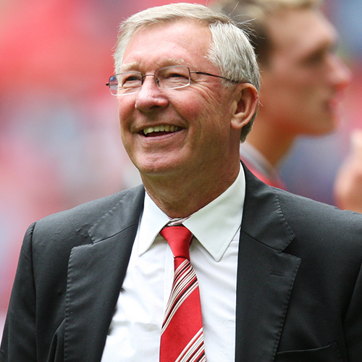
Case Study: Sir Alex Ferguson
There are a handful of instances of Man Utd winning games after scoring in 'Fergie Time', but one of the most notable is their 1999 Champions League final victory over Bayern Munich. Ole Gunnar Solskjaer and Teddy Sheringham came off the bench and scored two goals in added time to win the game 2-1 at Camp Nou. Teddy Sheringham came on in the 67th minute while Solskjaer came on in the 81st minute. Both were attackers. It showcases Fergusons understanding in bringing on the right players to win the match.
Ferguson’s teams had a knack for pulling out victories in the late stages of games. Analysis of game results shows that over 10 recent seasons, United had a better record when tied at halftime and when tied with 15 minutes left to play than any other club in the English league. He prepared his team to win. He had players regularly practice how they should play if a goal was needed with 10, five, or three minutes remaining. “We practice for when the going gets tough, so we know what it takes to be successful in those situations” United practice sessions focused on repetition of skills and tactics.

Slide 35
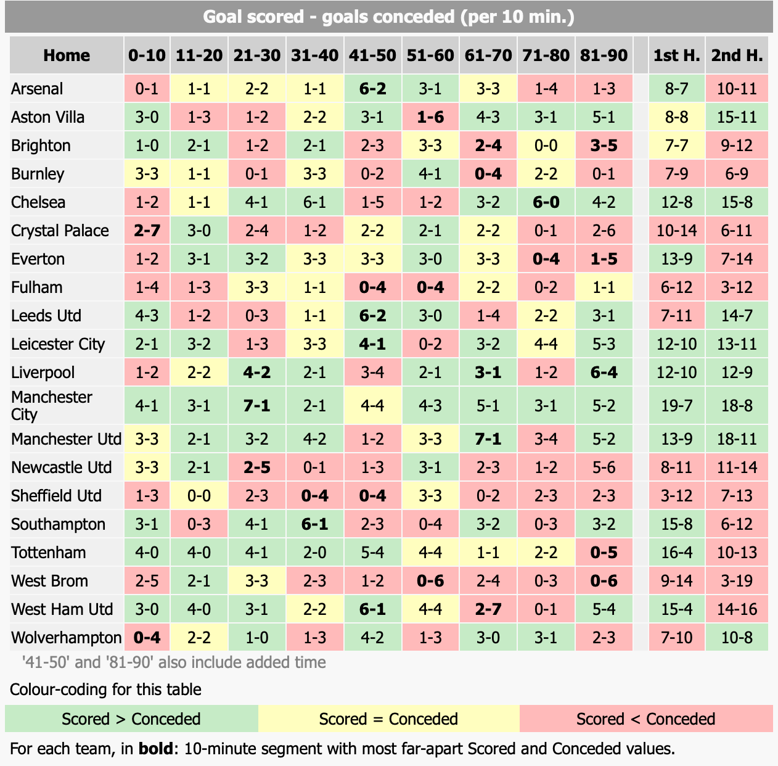
How Other Teams Score Home Goals
This graph from the Premier League showcases the number of goals scored and conceded per ten minutes in matches. Manchester United have an excellent 5-2 positive goals scored in the last 10 minutes, showcasing the affect Sir Alex Ferguson has had on his club. West Brom and Tottenham are 2 teams who have a poor tendency to concede more goals than score in the 81-90th minute. Teams will examine these statics to assess when to bring in certain players, or when to change formation or use different tactics. Both Everton and Crystal Palace tend to get complacent late in games give away easy goals. To improve goals conceded late in matches, managers from the 2 clubs should bring in more experienced players in the last 10 minutes to ensure the stability of the team resulting in better success rates.

Slide 36
Conclusions of Project for Maintaining Athletic Performance in the last 10 minutes of Competition.
I thoroughly enjoy partaking in this Project.
I found the project to be interesting and beneficial for me as an athlete and the information researched was extremely useful as I peruse my sports career.
I found the nutritional topic very eye-opening as I now know which food types are good for my body and how to use them.

Slide 37
Conclusions of Project for Maintaining Athletic Performance in the last 10 minutes of Competition.
The psychological aspect was an area that I had not been exposed to before this project. It must be an essential part of my preparation for the last 10 minutes of competition.
I now understand what food types that are beneficial, especially the timing and quantity required. This will benefit my final 10 minutes performance.
The survey of elite athletes was very beneficial, as I gained an insight into their minds and their approach to Competition and Performance Anxiety. I plan to use the information found in the survey and Implement it into my sporting mentality and game plan.

Slide 38
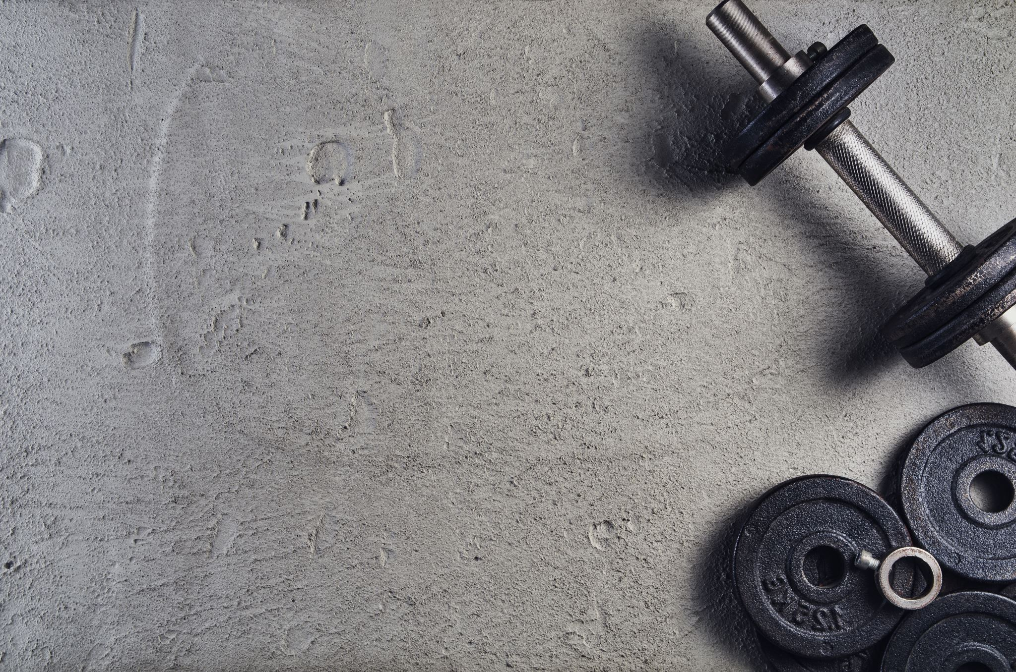
Conclusions of Project for Maintaining Athletic Performance in the last 10 minutes of Competition.
While I always strived for physical fitness, I have learnt that physical preparation and training for the last 10 minutes must be focused on not only physical fitness, but also skill preparation, along with a combination of psychological and nutritional preparation.
I have now learned to make my physical preparation for the last 10 minutes more specific, along with ensuring my energy is spent more appropriately in the match to so there is sufficient energy for the end.

Slide 39
With Thanks to the following;
Soccer; Kevin Doyle International Soccer Player.
GAA; Liam Griffen, Manager, Wexford Hurlers All Ireland Winners 1996.
Tom Dempsey, Hurler ,Wexford Hurlers All Ireland Winner 1966.
Martin Quigley, Multiple GAA All Star Wexford Hurler.

Slide 40
And Thanks to the following;
Cycling; Sean Kelly, World Number 1 Cyclist 1982 –1989
Philip Cassidy, Olympic Cyclist & Rás Tailteann Winner
Conor Dunne, Retired Professional Cyclist & TV presenter.
Rugby, Colm Quigley, Inter- Pro Rugby Player

Slide 41
References
https://www.goal.com/en/news/what-is-fergie-time-manchester-uniteds-history-of-late-goals/iqs4qho529891hykg171hhtbc
https://believeperform.com/resiliency-football/
https://hbr.org/2013/10/fergusons-formula
https://shapeamerica.tandfonline.com/doi/abs/10.1080/02640414.2014.901551#.YGH_9a9KiM8

Slide 42
https://believeperform.com/resiliency-football/
https://www.soccerpsychologytips.com/2014/how-to-become-resilient-like-elite-soccer-players/
https://media4.fcbarcelona.com/media/asset_publics/resources/000/158/492/original/FCB-GSSI_Sports_Nutrition_Guide_-_English_v1_16.4.v1430213934.pdf
https://www.researchgate.net/publication/8683409_Endurance_and_Strength_Training_for_Soccer_Players
https://www.playawayglobal.com/how-to-improve-my-stamina-for-football/

Slide 43
https://bjsm.bmj.com/content/55/8/416#T3
https://bjsm.bmj.com/content/55/8/416#T3
https://www.sportsjoe.ie/football/premier-league-football-diet-205125
http://www.5-a-side.com/nutrition/11-awesome-pre-game-meal-ideas/
https://truesport.org/hydration/pre-game-hydration-for-youth-athletes-faq/#:~:text=It%20is%20recommended%20that%20youth,before%20their%20game%20or%20practice.

